Slide 1
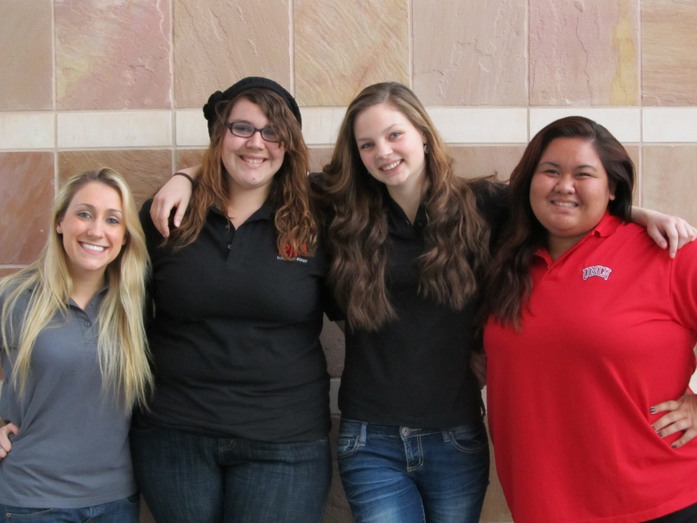

Priority Room Selection
2012-2013
UNLV Housing & Residential Life The complete campus experience

Slide 2
Why participate?
Priority Room Selection (PRS) is your opportunity to choose your room for next year and continue having easy access to resources that will help you succeed. You can always apply for housing, but you get first pick and other perks when you come to Priority Room Selection!

Slide 3
2012-2013 Financial Incentives
Lower room rates (singles are $600 less, doubles are $475 less)
    Rates locked in for next three years
Tiered pricing structure between residence halls
Book scholarships
    Awarded only at Priority Room Selection
    First 150 students at PRS receive $200
$125 application fee waived for “returners”
    Saving current residents $116,750!
$325 space reservation fees waived for “returners”

Slide 4
How do I participate?
To participate in the Priority Room Selection process you must:
1. Be a current resident. Commuters may not participate in any portion of the Priority Room Selection Process.
2. Apply online at housing.unlv.edu.
The $125.00 space reservation fee is waived for current residents

Slide 5
When is PRS?
9am-1pm every day, on the following dates:
February 13-17, 2012
March 12-16, 2012
April 16-20, 2012

Slide 6
How does PRS work?
1. Select a day and time during the room selection period.
2. Bring your RebelCard with you.
3. Bring a book or magazine to pass the time should you have to wait.
4. Have a few housing selection plans just in case plan “A” doesn’t work.
Once you are called, you’ll meet with a staff member to select your room assignment from a floor chart of the building of your choice. You’ll see which spaces have already been selected and where vacancies are.

Slide 7
Choose your room and suitemates!
If you want to guarantee that a room or suite is held for you and your friends, come together to priority room selection!
1. Request each other on your housing applications;
2. Come together on the same day; if you can’t all come together complete a proxy form so your friend can choose for you!
Proxy forms are available on our website.

Slide 8
How do I get a proxy?
If you’re unable to participate in PRS, you can authorize someone to be your proxy and select your room! S/he will go through the described procedure in your place.
You must provide your proxy with the following items:
* A photocopy of your RebelCard
* A completed and signed proxy application
Current residents who do not participate in PRS will be placed on a space-available basis with all incoming residents.

Slide 9
Special Interest Floors
Tonopah South 1- All Female
Tonopah Center 6 - Honors House/Study Intensive
Tonopah South 6 - Study Intensive
C Hall 1 - Global House
C Hall 2 & 3 – Hotel House
Faiman Hall 3 - Graduate & 23 or Older

Slide 10
Tonopah Room Rates
Tonopah Single = $3,720
Tonopah Double = $2,940
Tonopah Triple = $2,940
All rates are per semester
All rates are guaranteed for three years

Slide 11
South Room Rates
South Single = $3,320
South Double = $2,700
All rates are per semester
All rates are guaranteed for three years

Slide 12
UCC Room Rates
Hughes Deluxe Single = $3,520
B Hall Deluxe Single = $3,520
C Hall Single = $3,520
C Hall Double = $2,800
Faiman Single = $3,520
Faiman Double = $2,800
All rates are per semester
All rates are guaranteed for three years

Slide 13

2012-2013 Meal Plan Rates
Unlimited+200 = $2,322
Block 240+250 = $2,134
Block 210+300 = $2,024
Block 180+350 = $1,968
Block 150+400 = $1,912
Block 120+450 = $1,840

Slide 14
New for all residents!
Wireless in all rooms, lounges, conference rooms
A mega-Cable TV package with Cox Communications
Deluxe singles in UCC
Two community kitchens in the Upper Class Complex

Slide 15
2012-2013 Important Dates
PRS Week 1: February 13-17, 9am-1pm
PRS Week 2: March 12-16, 9am-1pm
PRS Week 3: April 16-20, 9am-1pm
June 1 - $500 cancellation fee (returners)
July 30 – Assignment packets to residents
Move in Day August 23-24
Housing balance due when tuition is due/1st day of classes
Payment plans available through MyUNLV

